Slide 1
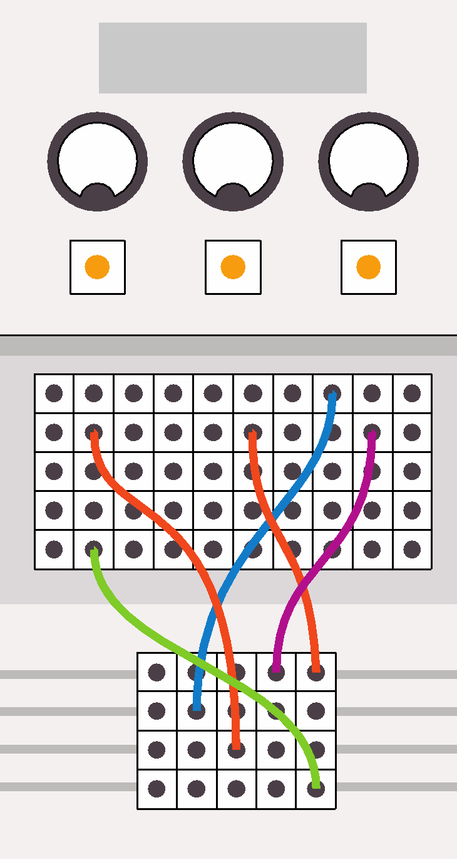
Computing:
past, present and future
Lesson 3: Moore’s Law

Slide 2
Objectives
In this lesson, you will learn:
about Moore's Law
how computer technology has developed and changed over time
how to create a report using word-processing software.

Slide 3
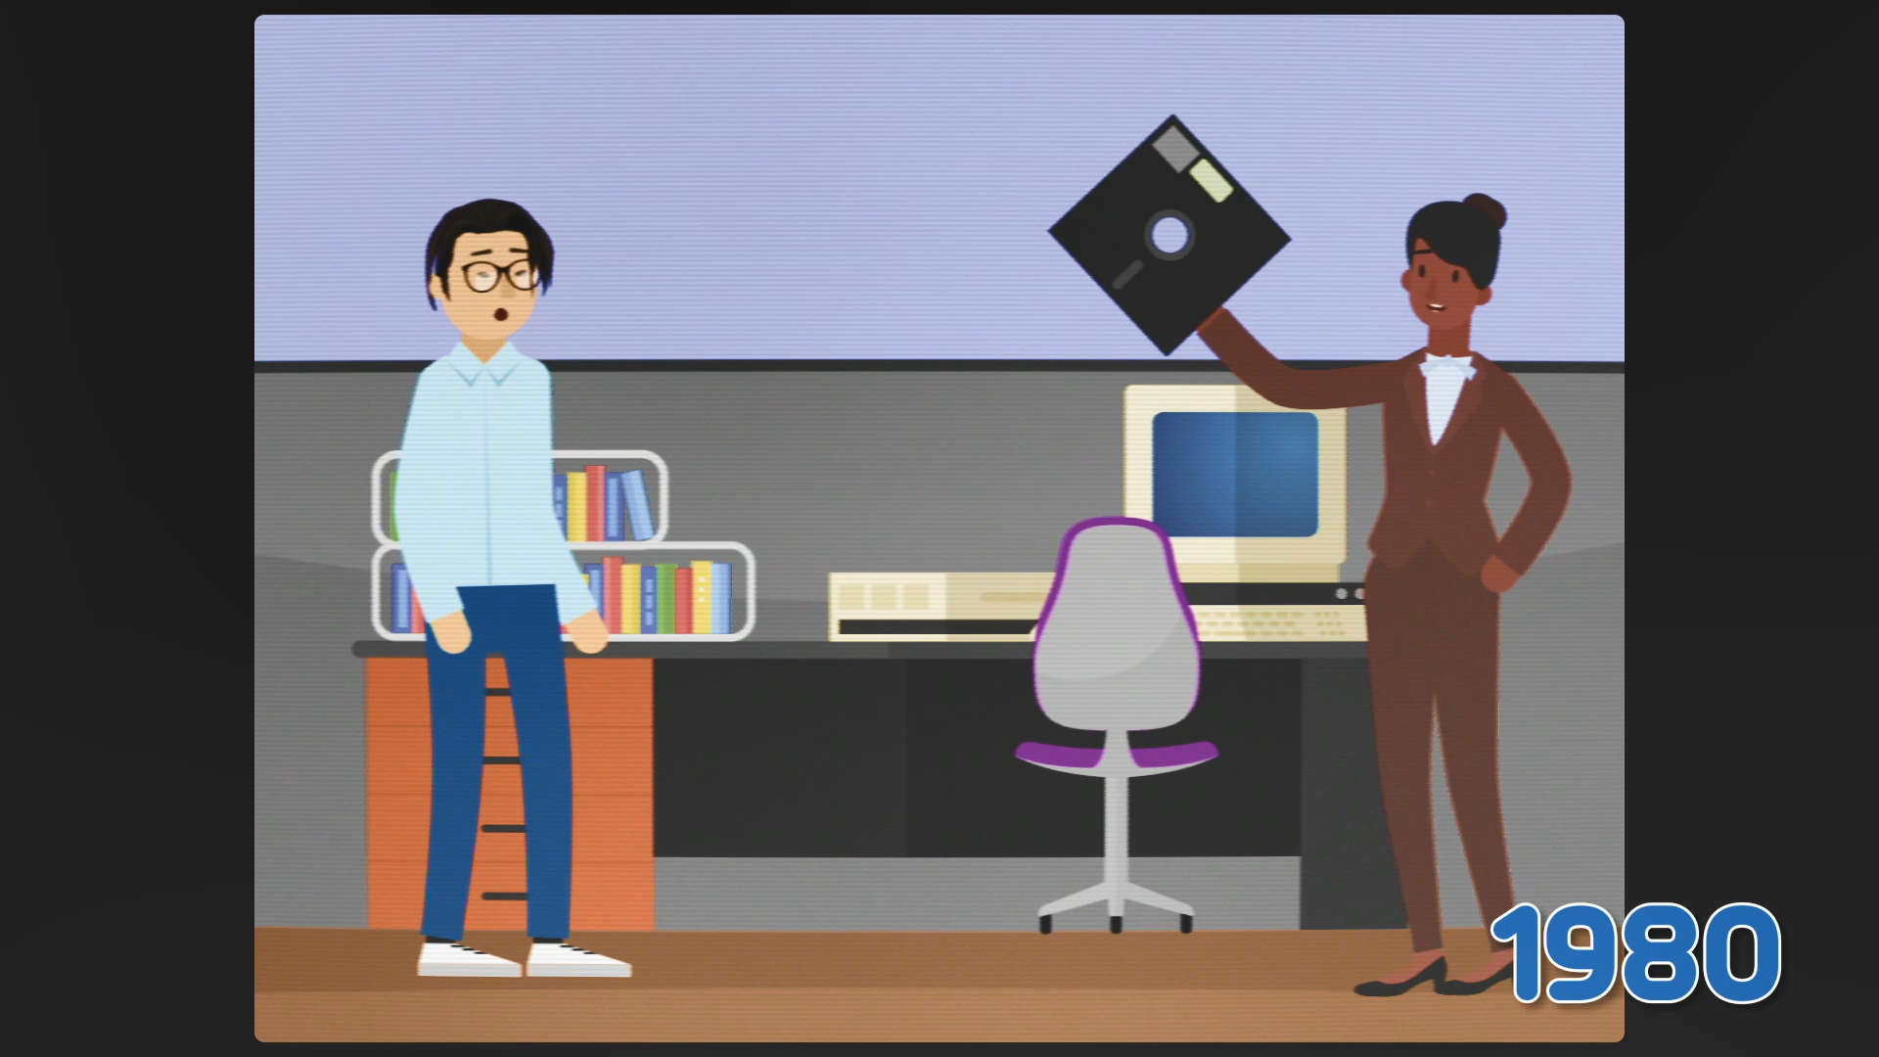
Watch Animation 3.1: The incredible shrinking computer

Slide 4

Gordon Moore
Moore’s Law is named after Gordon Moore.
In 1965, Moore founded Intel Corporation with Robert Noyce.
Intel was to become the world's largest producer of computer microchips.

Slide 5
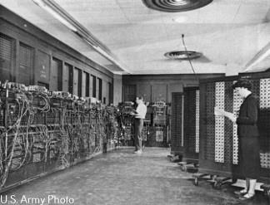
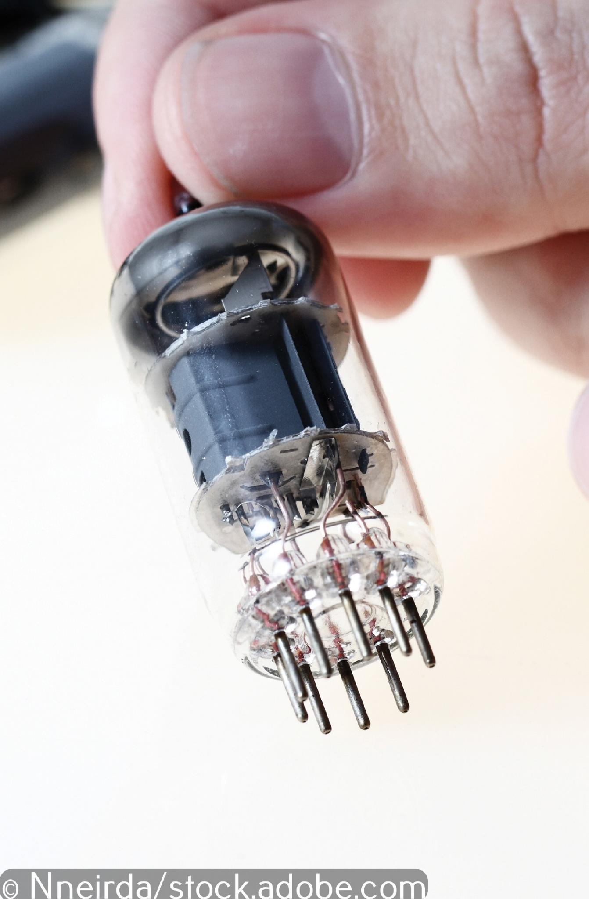
The 1940s: valve computers
The early computers were enormous. They filled a large room.
The switches used to process data were valves the size of a thumb.
ENIAC, the first electronic general-purpose digital computer, contained nearly 18,000 valves within its circuits. That might sound like a lot, but ENIAC's processing power was miniscule; less than a small electronic calculator today.

Slide 6
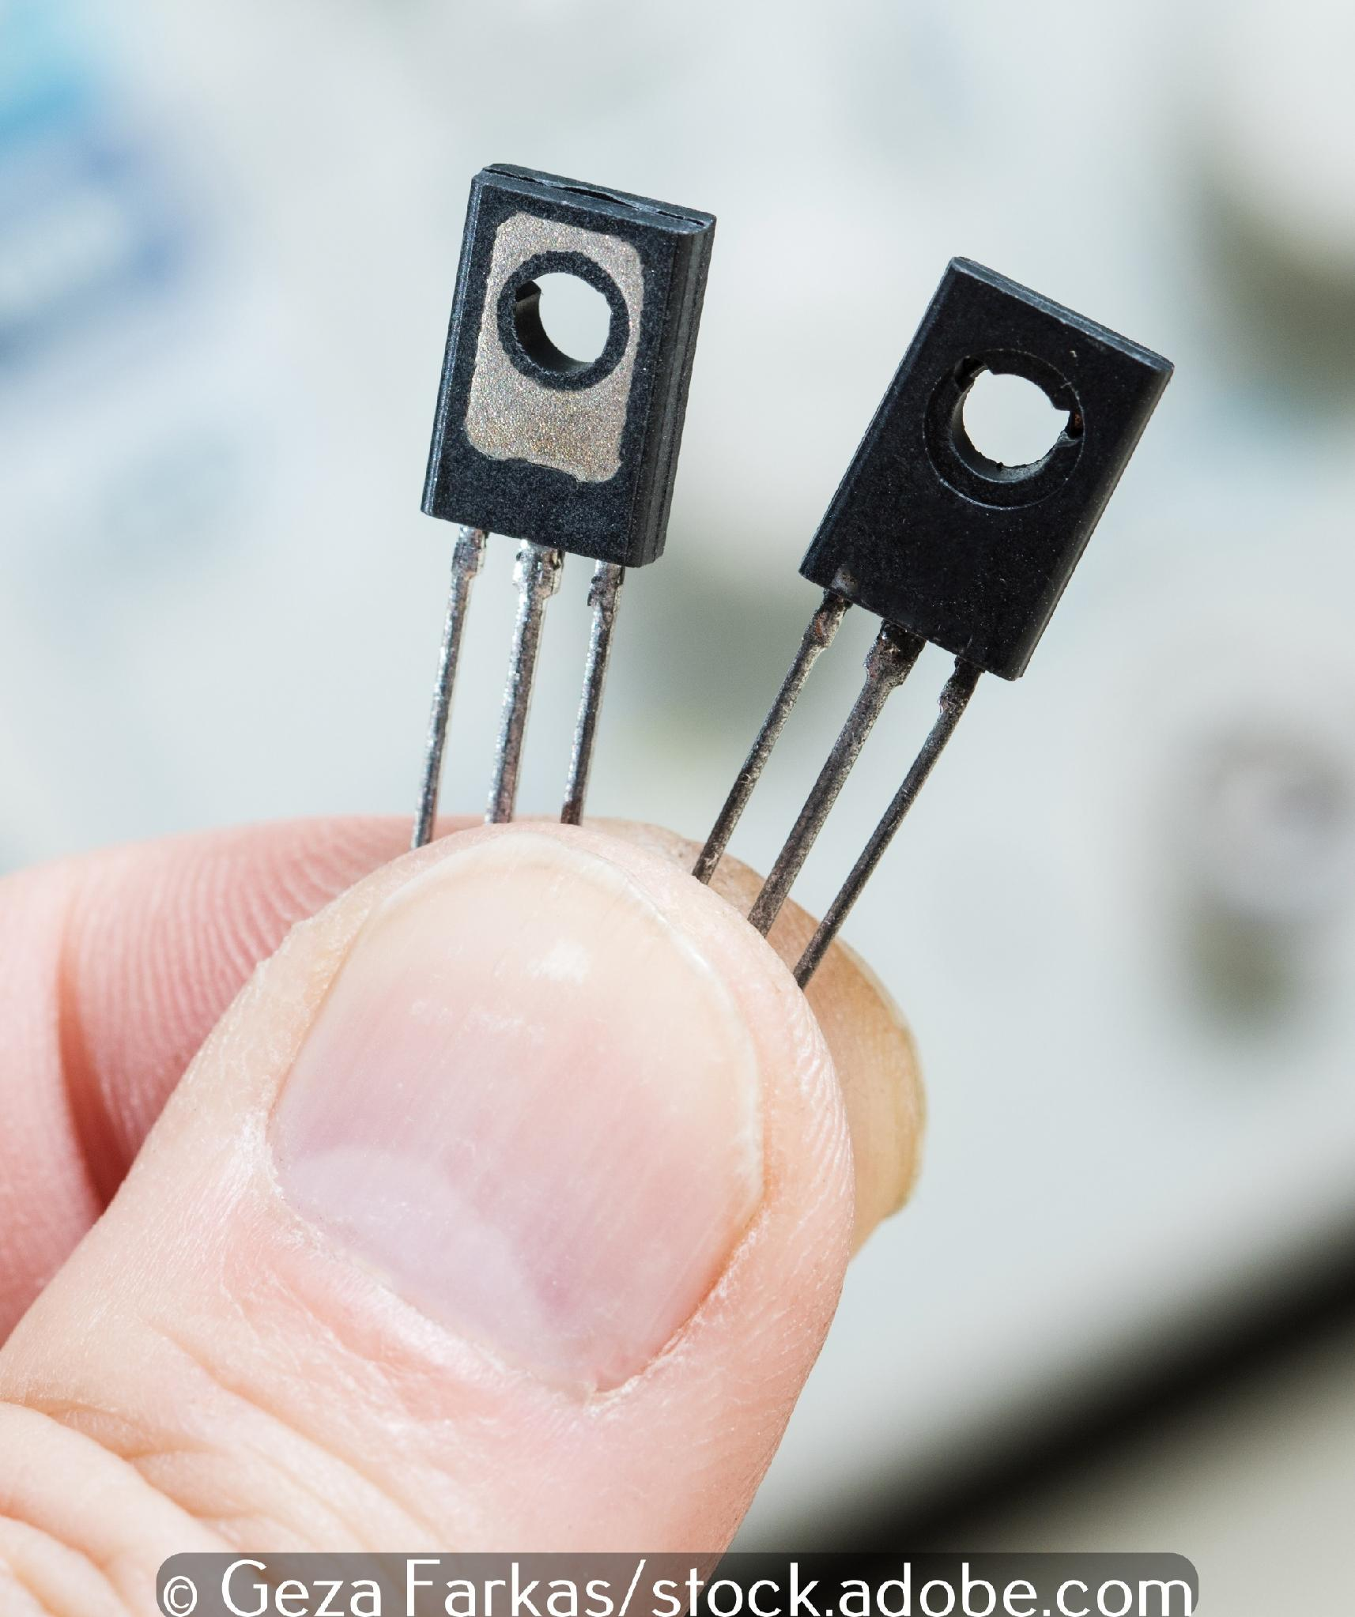
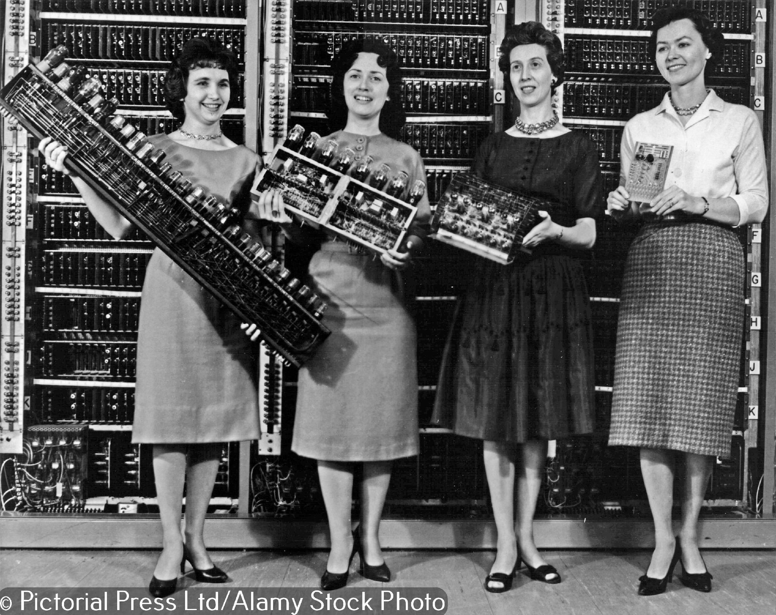
1947: the invention of the transistor
The first big reduction in in the size of electronic computers came when valves were replaced by much smaller transistors.
These computer pioneers are holding circuit boards from four generations of early computers, from ENIAC on the left to BRLESC on the right. The BRLESC circuit board contains transistors; look how much smaller it is.

Slide 7
1959: the invention of the microchip
The next big reduction in the size of electronic computers came when transistors were replaced by microchips.
Many tiny transistors can be etched into a single silicon microchip and, with each transistor added, the processing power of a device increases.
All our digital devices today contain microchips.

Slide 8
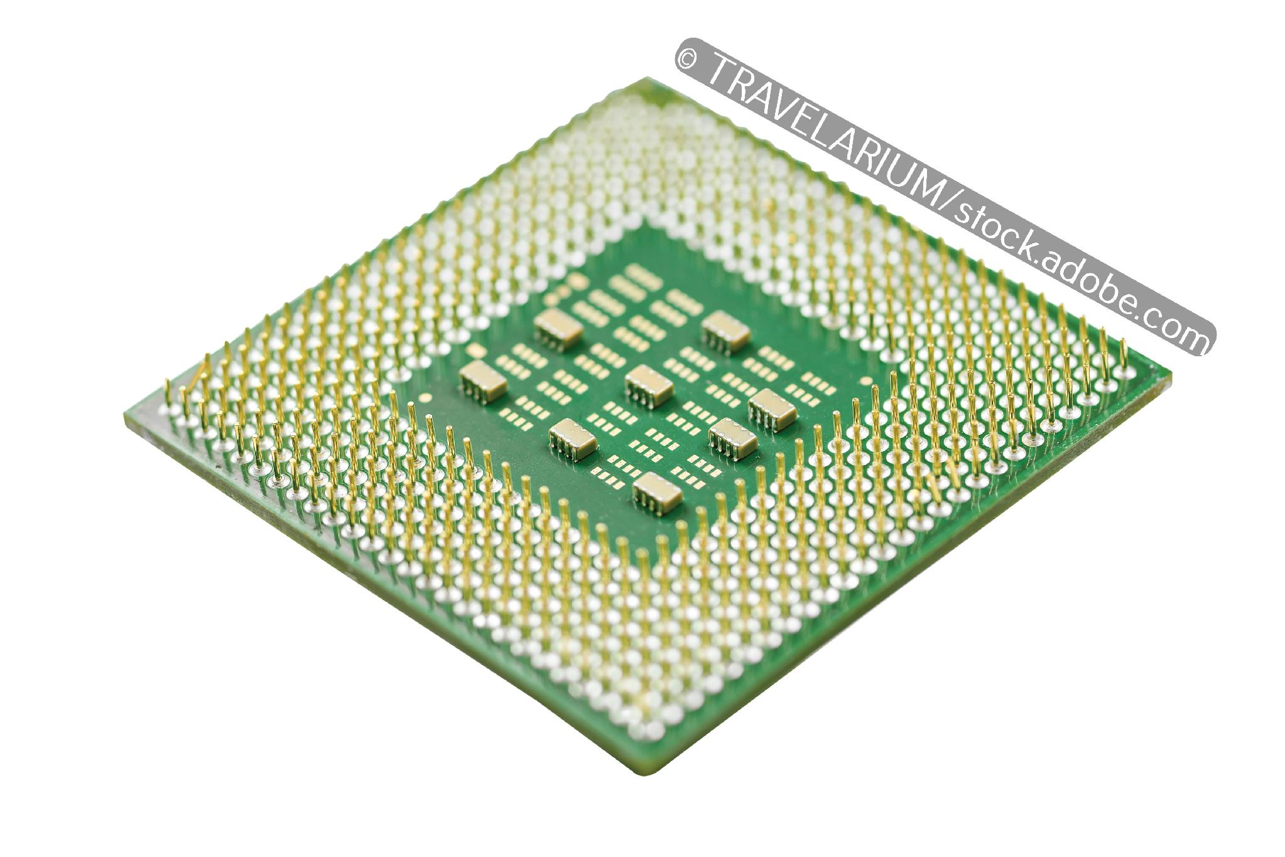
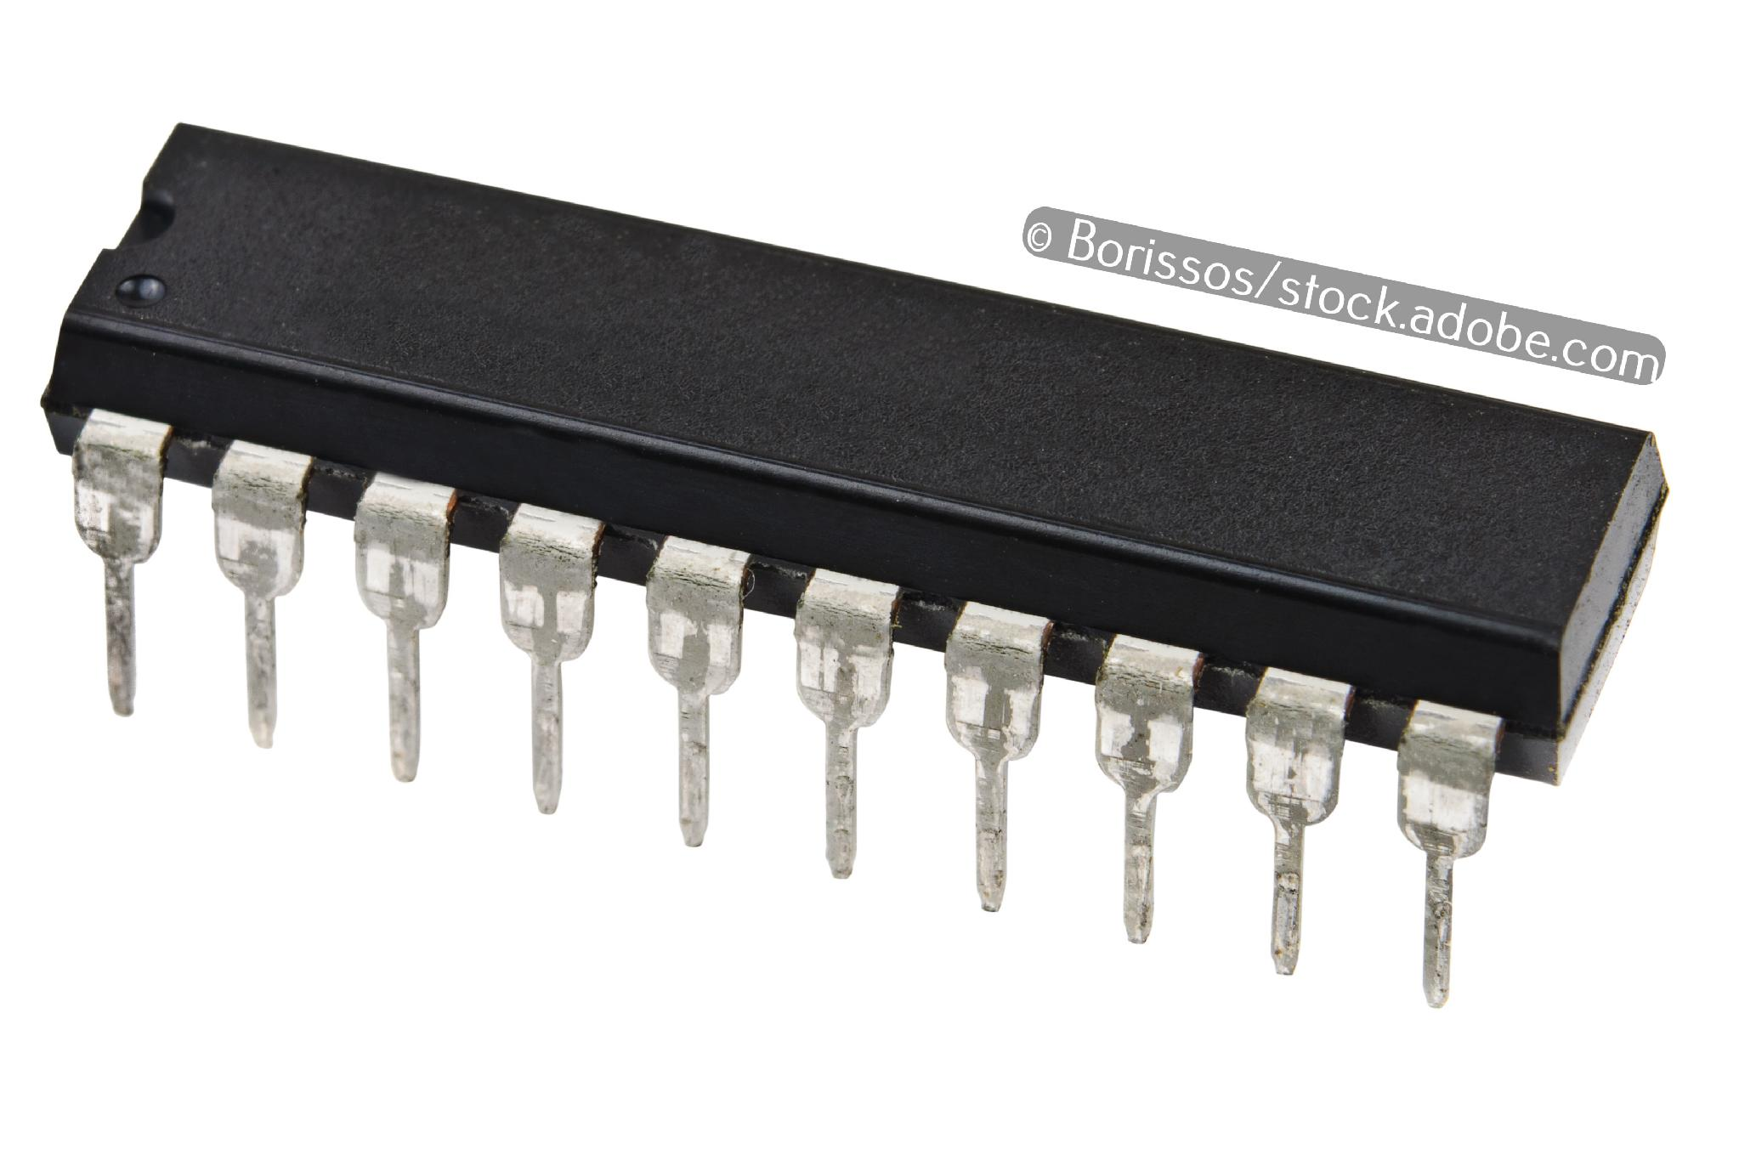
Moore’s observation
As a chip developer, Moore had observed the gradual miniaturisation of the transistor and the increase in the number of transistors that could be etched onto a microchip.
He pointed out that the number of transistors on a single microchip was doubling about every two years.
In the mid-1960s, Moore predicted that this exponential trend would continue into the future and this is Moore’s Law.

Slide 9
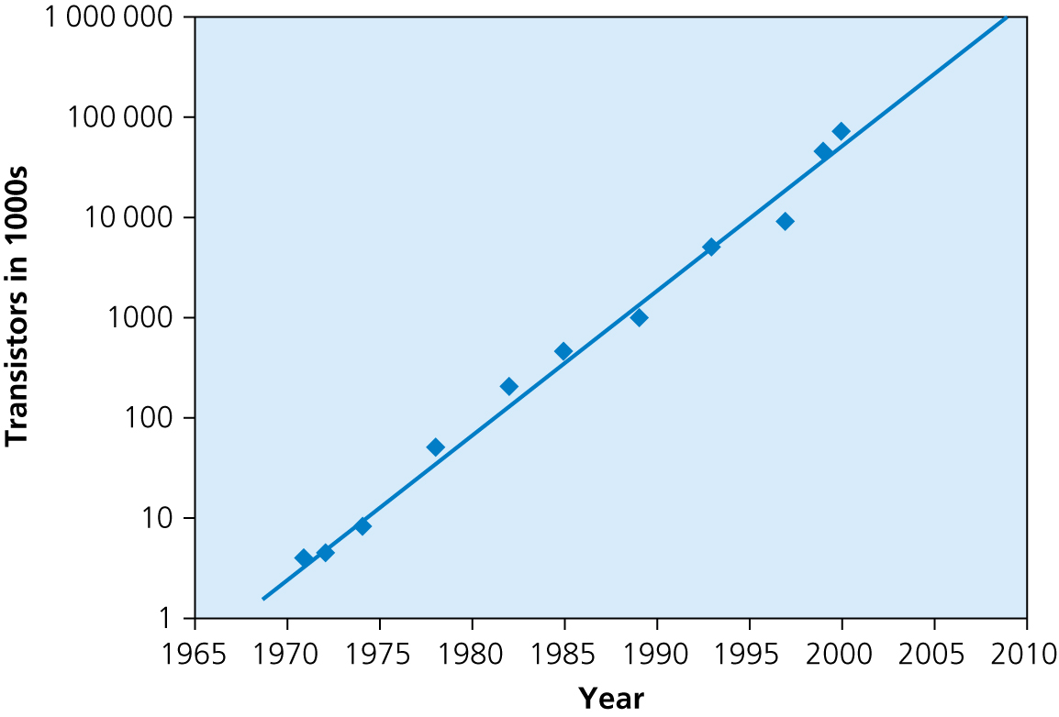
Moore’s Law graph
If we draw a line on a graph to represent Moore’s Law and plot the development of the number of transistors on a microchip, we can see that Moore accurately predicted the development of the microprocessors at the heart of our digital devices many decades into the future.
The data from the graph is as follows:
Processor | Year | Number of transistors
4004 | 1971 | 2250
8008 | 1972 | 2500
8080 | 1974 | 5000
8086 | 1978 | 29,000
286 | 1982 | 120,000
386TM processor | 1985 | 275,000
486 TM processor | 1989 | 1,180,000
Pentium® processor | 1993 | 3,100,000
Pentium® II processor | 1997 | 7,500,000
Pentium® III processor | 1999 | 24,000,000
Pentium® 4 processor | 2000 | 42,000,000
Xeon® processor | 2008 | 1,900,000,000

Slide 10
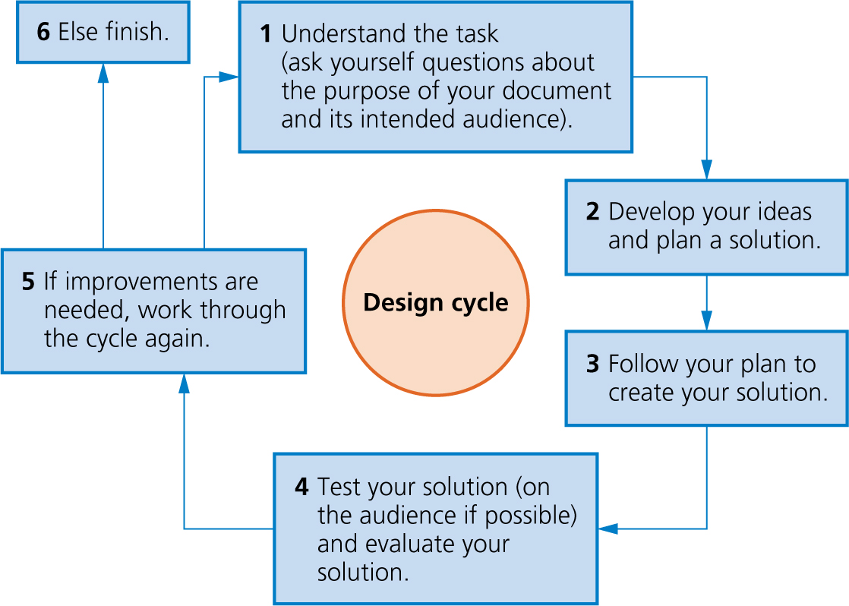
The design cycle

Slide 11
The qualities of a well-designed report
The report has a title. It could also have a sub-title.
Headings and sub-headings are used to break up large chunks of text.
Line spacing and margins ensure the content is easy to read and doesn’t feel cramped.
Images add meaning to the text and are accompanied by captions. Text could flow around images.
The number of fonts, font sizes and font colours is limited; too many can be confusing.
The information is logically ordered so that the narrative flows from one point to the next.
Data, in the form of tables or graphs, is used to support the text if appropriate.
All sources of information are cited.

Slide 12

Activity 3.1: A report on Moore's Law

Slide 13
Activity 3.2: Commenting on your partner’s report
Swap computers with a partner and use the comments tool to give feedback on the design of your partner’s report.
Remember to save your partner’s document when you have finished adding your comments.

Slide 14
Quiz 3

Slide 15
Activity 3.3: Finishing your report
Evaluate the feedback you received on your report and make improvements.
Remember to ‘Save as’ before you begin making improvements, so you always have your partner’s comments to refer back to.

